Slide 1
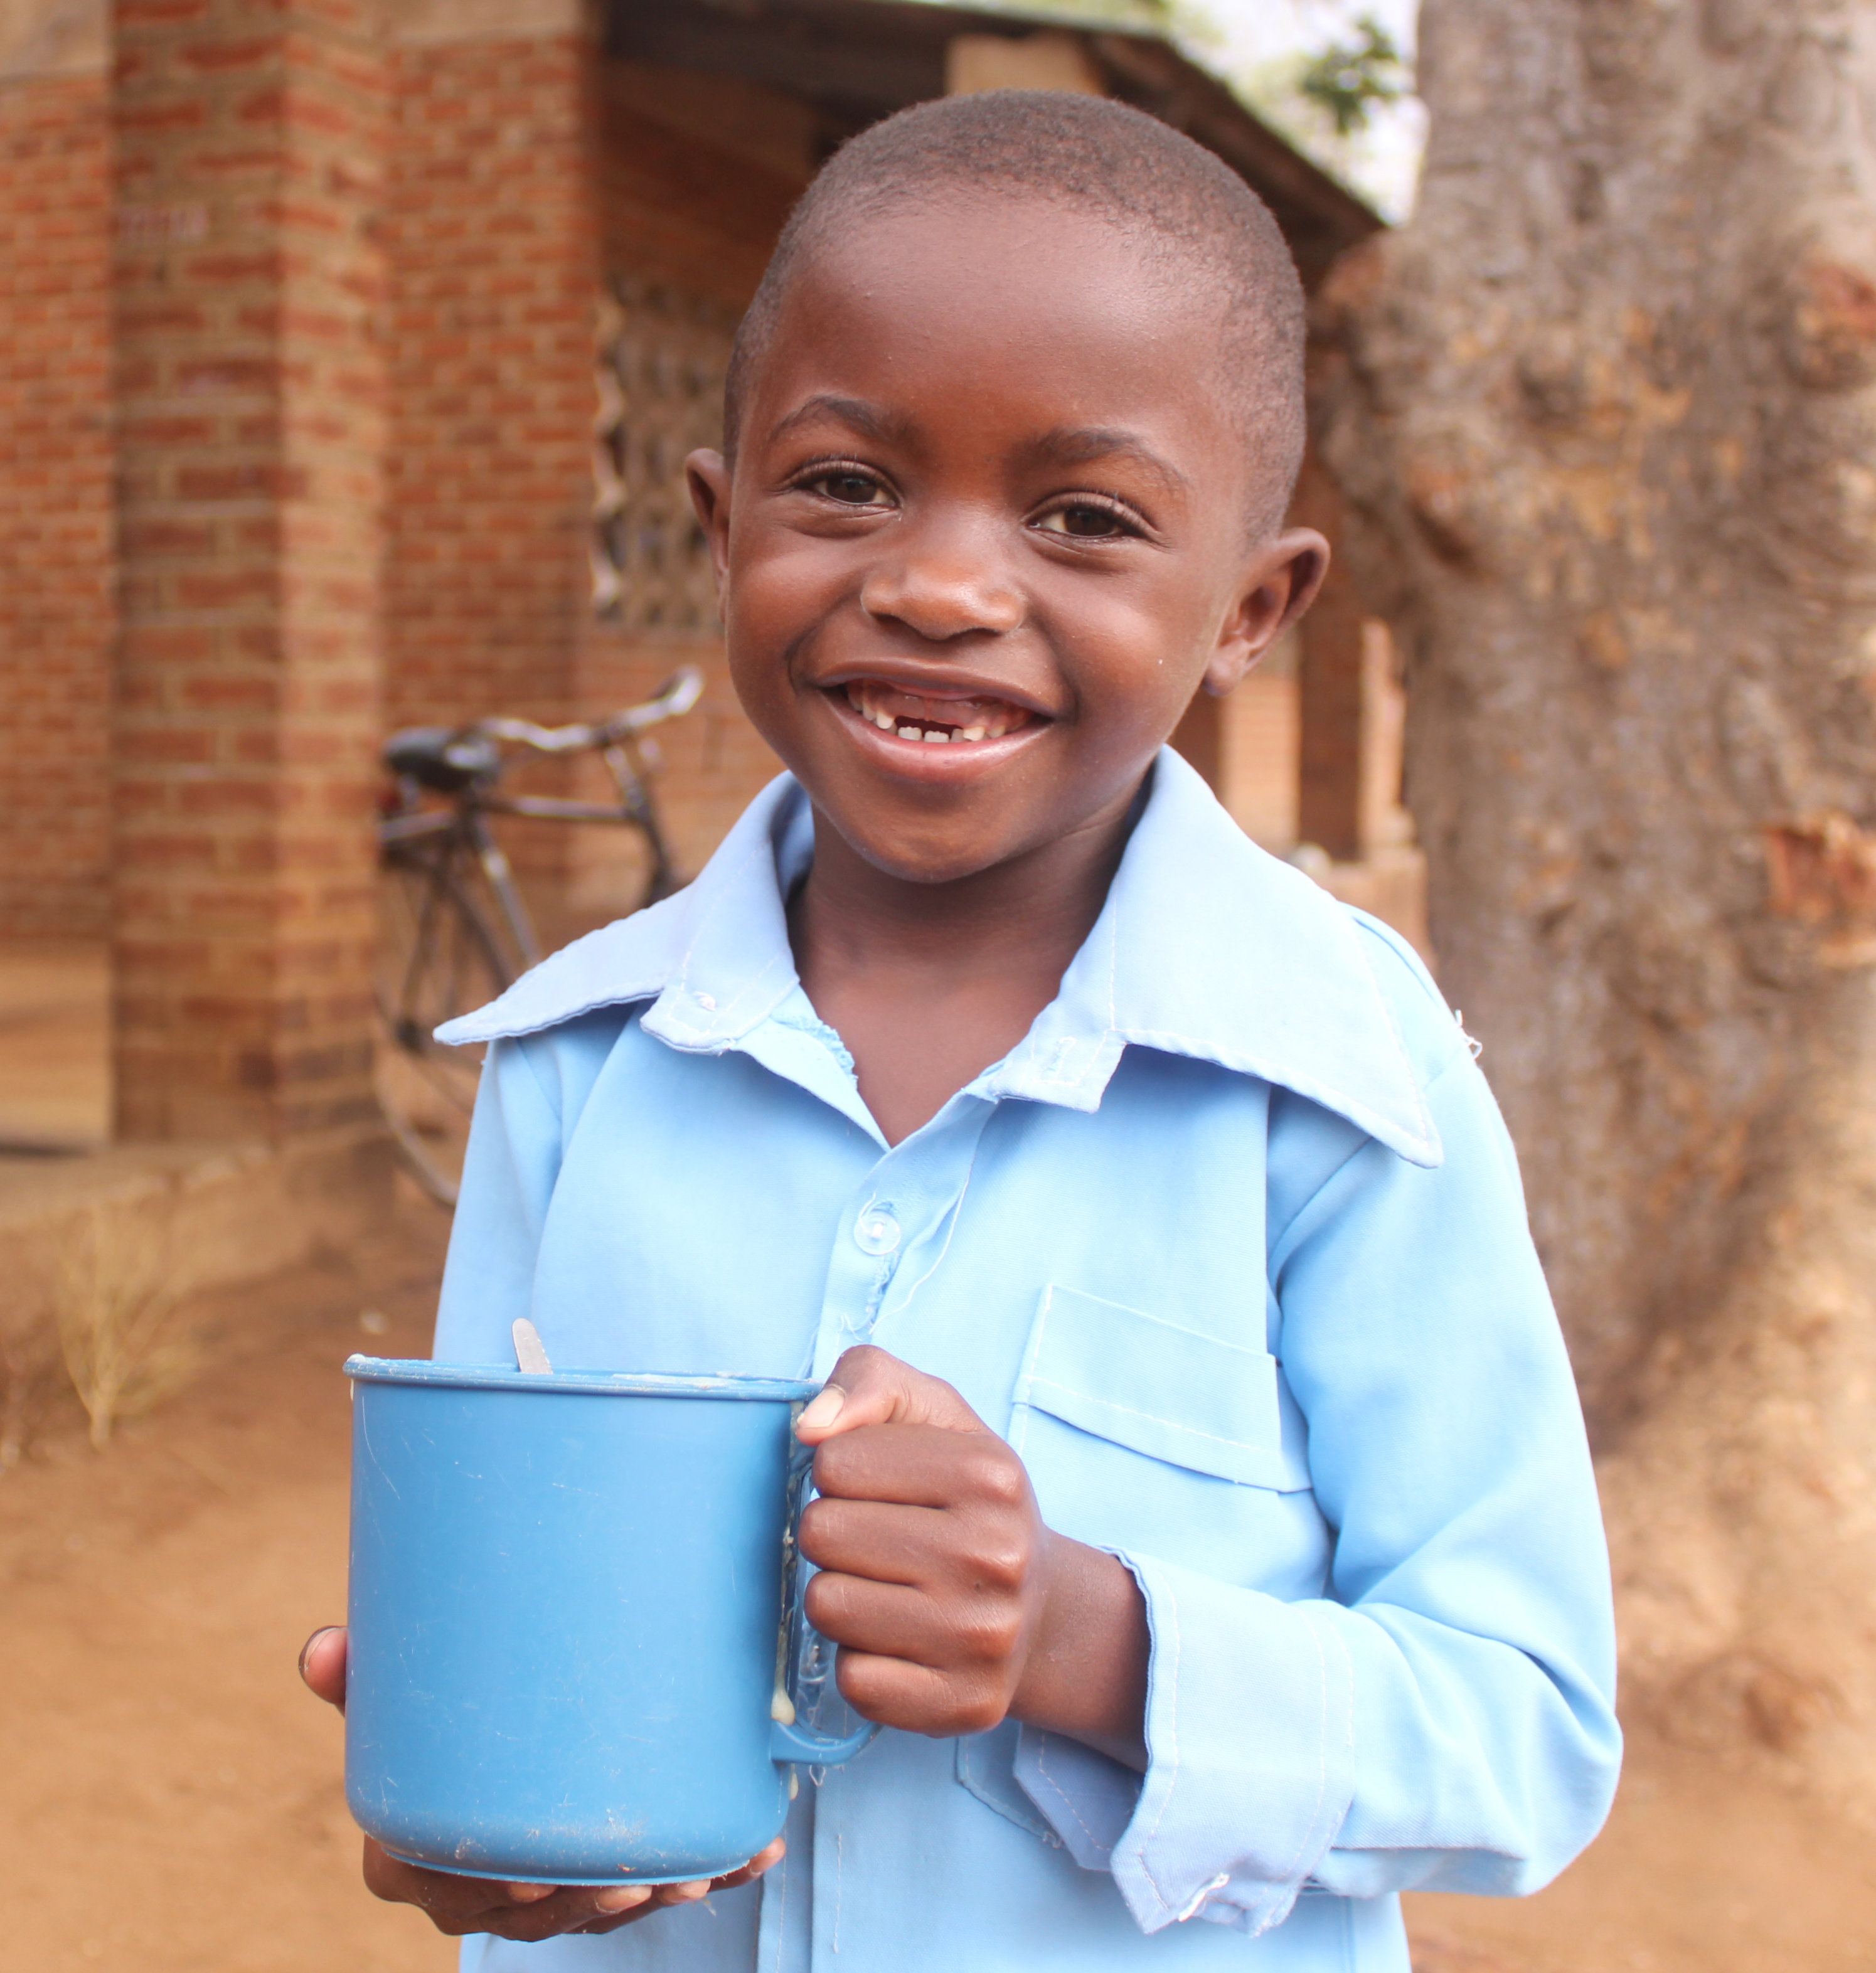
Executive Director Mary’s Meals UK
Remote working from anywhere in the UK February 2025
Recruitment pack Executive Director

Slide 2
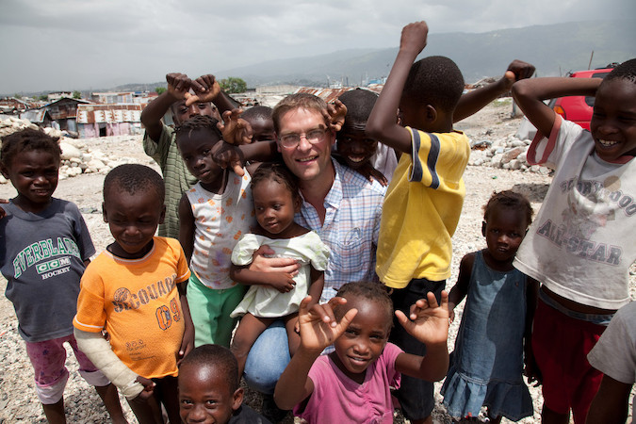
Welcome from our CEO and Founder
Thank you for your interest in the role of Executive Director. I hope you will find this pack informative and useful in supporting your decision to apply to join our team of employees, which exists to serve a global movement of people who are united around a simple mission; the provision of a daily meal in a place of education for the world’s poorest children.
This meal, cooked and served by local volunteers, meets the immediate need of the hungry child and, at the same time, plays a key role in encouraging them into the classroom where they gain an education that can set them free from poverty. Today we serve over 2.4 million children each school day in 18 of the world’s poorest countries. This global movement of ours is achieving something wonderful, each meal served is the product of a series of lots of ‘little acts of love’ carried out by people across many countries who freely give their time, money, skills or prayers and it is through that, that our movement grows.
Our work is named after Mary, the mother of Jesus, and our values and culture are rooted in and shaped by a Christian spirituality. We feel that the way we do things is as important as the end results. Ours is also a universal mission involving people of all faiths and none across the world. Everyone is invited to join and provide their own unique contribution to this work.
With 67 million children out of school around the world and a further 73 million attending school so hungry they’re not able to concentrate and learn, our work is only just beginning. Will you play a crucial part in shaping the future of Mary’s Meals UK and, with it, the lives of so many people who both contribute to and benefit from this incredible work of love, joy, and hope?
Good luck with your application!
Magnus MacFarlane-Barrow
CEO and Founder

Slide 3
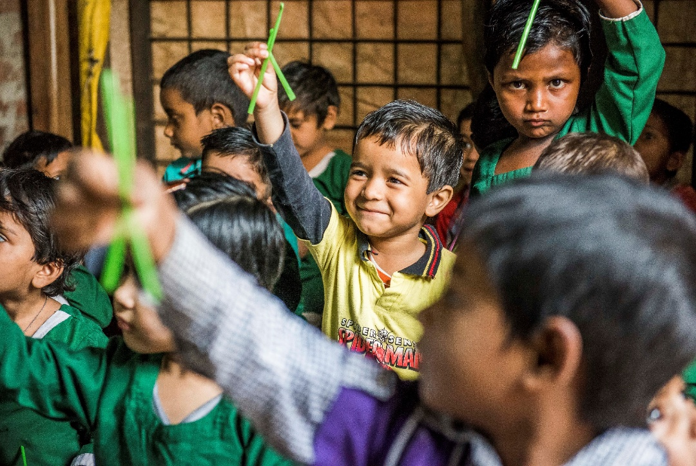
About the Mary’s Meals movement
The Mary’s Meals campaign was born in 2002 when Magnus MacFarlane-Barrow, from Dalmally in Argyll, visited Malawi during a famine and met a mother dying from AIDS. When Magnus asked her eldest son Edward what his dreams were in life, he replied simply: “I want to have enough food to eat and to go to school one day.”
That moment was a key part of the inspiration which led to the founding of Mary’s Meals.
Today, 20 years later, we feed more than 2.4 million hungry children every school day across four continents.
In January 2015, to recognise the incredible growth of the Mary’s Meals movement around the world and to facilitate future growth in new countries, another entity – Mary’s Meals International (or ‘MMI’) – was formed.
Mary’s Meals has 16 registered national affiliate organisations, who raise awareness and funds for our work around the world. All funds raised by the national affiliates are passed to Mary’s Meals International, which co-ordinates our movement and directly manages the delivery of our school feeding programmes.
Wherever possible, Mary's Meals uses locally grown food to support the local economy and help smallholder farmers.
We work extremely hard to keep our running costs low, which means that it costs just £19.15 to feed a child with Mary’s Meals for a whole school year.
This is only possible because most of our work is done by an army of dedicated volunteers all over the world, who carry out lots of little acts of love on behalf of Mary’s Meals.
Having been inspired, in part, by our founder’s Catholic faith, this work is named in honour of Mary, the mother of Jesus, who brought up her own child in poverty. We consist of, respect and reach out to people of all faiths and none.

Slide 4
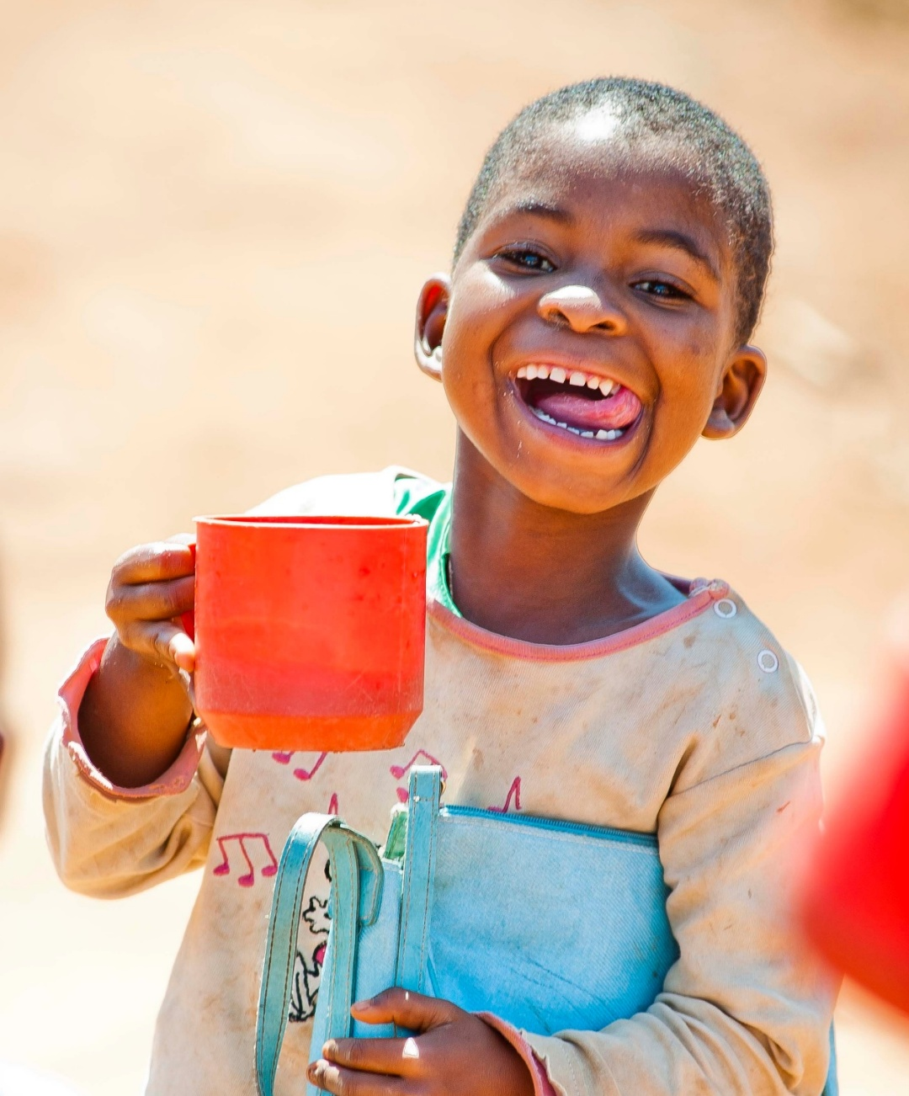
Our vision and mission
Our vision is that every child receives one daily meal in their place of education and that all those who have more than they need, share with those who lack even the most basic things.
Our mission is to enable people to offer their money, goods, skills, time, or prayer, and through this involvement, provide the most effective help to those suffering the effects of extreme poverty in the world’s poorest communities.

Slide 5
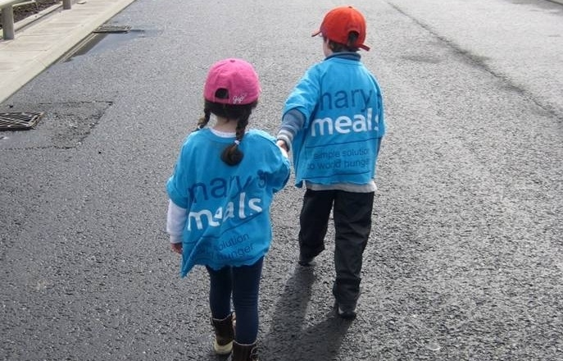
Our values
We have confidence in the innate goodness of people.
We respect the dignity of every human being and family life.
We believe in good stewardship of the resources entrusted to us.
View Mary’s Meals’ full statement of values here: Statement of Values

Slide 6
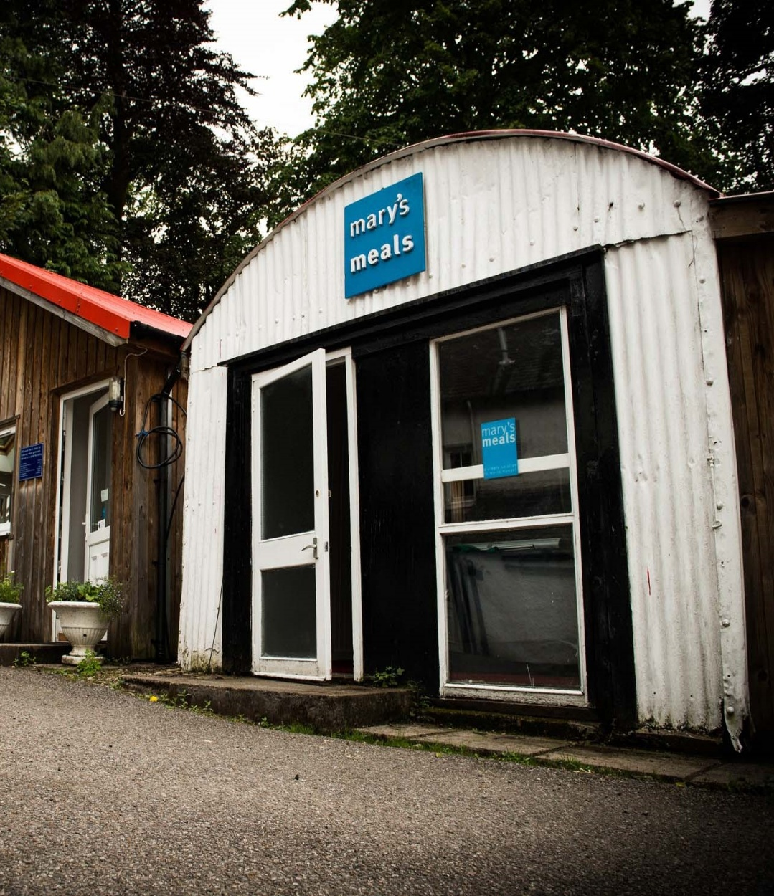
About Mary’s Meals UK
Mary’s Meals UK a charity registered in Scotland, is the oldest entity in the Mary’s Meals family – the original organisation established as Scottish International Relief in the early 1990s, when our Founder and CEO, Magnus MacFarlane-Barrow, first became involved in international aid during the conflict in the former Yugoslavia.
Back then, Magnus was a salmon farmer who, along with his family, decided to do something to help those who were suffering because of the war.
They relied heavily on the generosity of local people in their village of Dalmally in Argyll, who continuously donated food, blankets and other items of aid, which were then stored in the family shed, before being driven out by Magnus to Bosnia-Herzegovina.
Though our largest office is now in Glasgow, that same shed – which continues to be filled, metaphorically at least, with the generosity of our supporters – still serves as the headquarters of Mary’s Meals UK to this day.

Slide 7
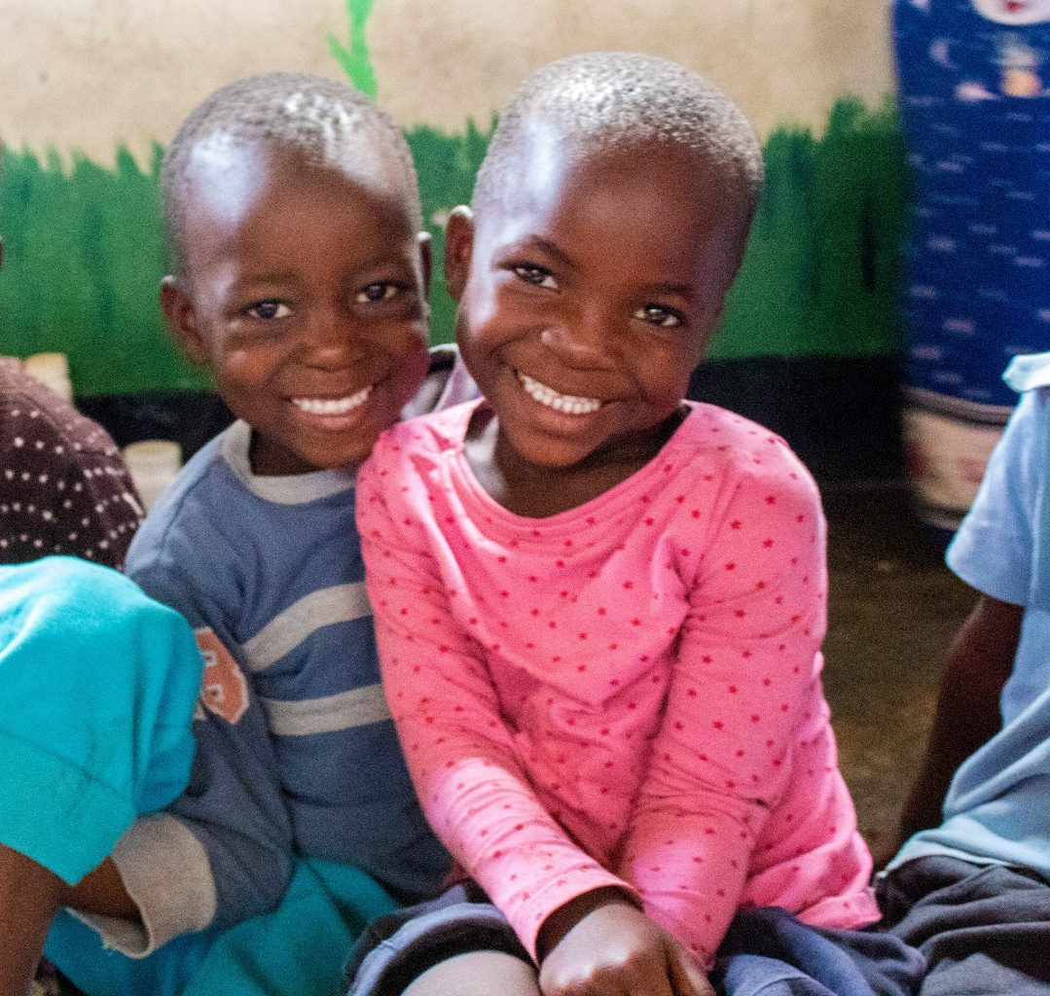
Mary’s Meals UK today
Today, Mary’s Meals UK raises awareness and funds under the direction of our Executive Director, and through the passion, commitment and dedication of our volunteers and staff, led by the Director of Communications, Director of Supporter Engagement, Director of Finance and Operations and Head of People.
Mary’s Meals is dedicated to fostering a culture which puts our deeply held values at the heart of everything we do. We work to a remote-first model however we do have offices in Glasgow and London that operated on a hybrid basis for those who wish to use them. We want employees to feel they are nurtured, listened to, valued and involved; we value the unique contribution of everybody involved in our work so you will be encouraged to bring your true self to work everyday.
We offer a fair and transparent approach to our compensation package. Our compensation and benefits package includes, 34 days annual leave (inclusive of UK public holidays), 8% employers pension contribution, life assurance, payroll giving and option to purchase up to an additional five days annual leave.
Our employees’ wellbeing is extremely important to us, therefore we offer various initiatives and benefits to support your overall wellbeing which include an Employee Assistance Programme, mental health first aiders, enhanced sickness pay, optical benefits and Cognitive behavioural therapy.
We strive to empower our employees, enabling them to carry out their role to the best of their ability by offering continuous learning and development initiatives which includes an annual training budget, inhouse learning management system and our own development programmes.
We respect and value the dignity of every individual and their family life. We understand the pressures of balancing home and work life therefore we offer a range of family friendly supportive policies.
You can learn more about our full benefits package by clicking here.

Slide 8
What our employees have to say
I've had fantastic opportunities for career development that have kept me learning and striving to do better work.
I appreciate all the efforts made regarding looking after our wellbeing with the many initiatives that have been offered to us.
The staff, volunteers and supporters are so passionate, dedicated and inspiring. It is also really fulfilling to work as part of an organisation that is making real change where it is most needed. It is a privilege to be part of the mission, and I think that feeling is something that unites us.
It's exciting to be part of an organisation that is growing so rapidly.
Knowing that what we do really does make a difference to the lives of the young people who depend on Mary's Meals.
I love the flexibility offered and how I can be at home for school runs and for anything urgent - I love the respect shown to family life.

Slide 9
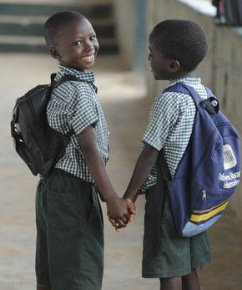
Executive Director
Reports to:
Accountable to the Trustees of Mary’s Meals, led by the Chair (with a dotted line to Chief Growth Officer – MMI)
Location:
Home working from anywhere in the UK with some travel across the UK, for board meetings/events.
Salary:
c. £71,402 - £75,751 per annum, plus London weighting where applicable
Key relationships:
MMUK SLT, MMUK Head of People, MMUK Board
MMI ELT
MMI CEO
Executive Directors across the MM Family
External supporters and donors

Slide 10
MMUK Senior Leadership team structure
Head of People
Director of Communications
Head of Media and Content
Head of Marketing
Director of Supporter Engagement
Director of Finance and Operations
Executive Director
Head of Supporter Care
Head of Philanthropy and Partnerships
Head of Finance
Head of Grassroots
Head of Institutional Giving and Partnerships
Head of Data and Operations

Slide 11
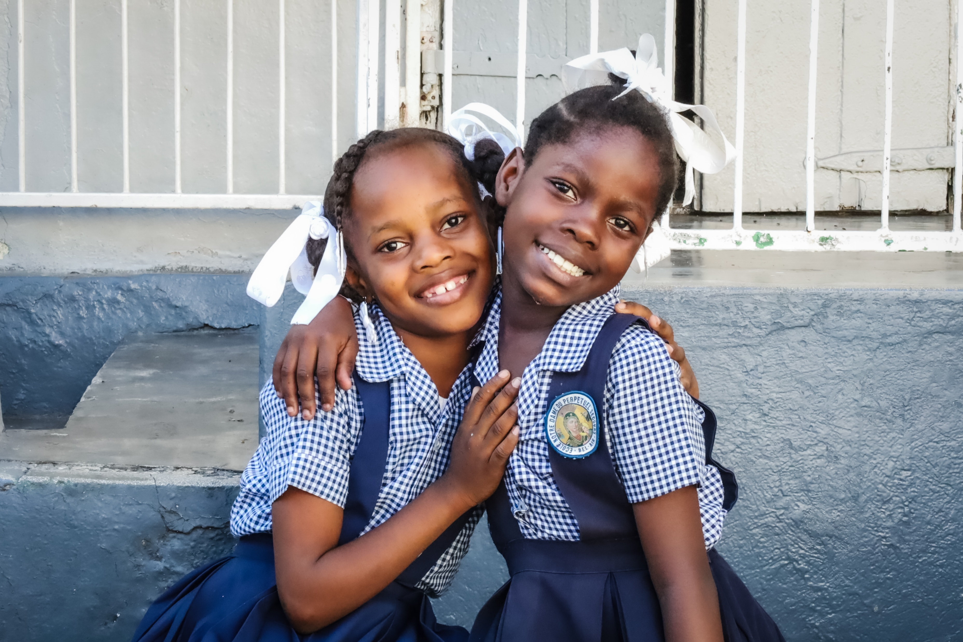
Job Description
As Executive Director you will provide inspirational strategic and operational leadership to Mary’s Meals UK (MMUK). You will work collaboratively with the Board, Senior Leadership Team (SLT) and MMI to lead significant growth across a variety of fundraising and awareness raising channels throughout the UK.
You will bring an entrepreneurial approach to growth, seeking new opportunities and forging new strategic partnerships to support agile growth both nationally and regionally, whilst also nurturing our existing deeply committed supporters. As the Executive Director of our biggest National Affiliate, you will work in close collaboration with Mary’s Meals International, as well as other international affiliates.
Key Responsibilities:
Strategy Development & Organisational Leadership
Ensure the Board receives accurate and timely information to make strategic decisions in order to fulfil their governance role.
Collaborate extensively with MMUK Trustees, the Chief Executive Officer, MMI and the Chief Growth Officer, MMI to lead the development and execution of the strategic plan for MMUK, maximising the opportunities and benefits of collaboration and alignment with MMI.
As needed, participates in Mary’s Meals global leadership conversations as a stakeholder in key decision areas.
Collaborate with leaders from Mary’s Meals International (MMI) to ensure close alignment across the network.
Board Relations
Serve as the primary liaison to the Board of Directors: manage, inspire and cultivate the board relationships.
Facilitate board involvement in the Mary’s Meals fundraising strategy.
Work with the MMUK Board Chair & Chief Executive Officer, MMI to support board recruitment and ongoing board development.

Slide 12
Strategy Development & Organisational Leadership cont.
Participate in the global National Affiliate Executive Director forum to collaborate on key initiatives to grow the global movement.
Build and maintain an organisational culture of collaboration, humility and innovation.
Responsible for the financial decisions of MMUK adjusting course as needed, to protect the organisation’s assets and ensure financial and charitable statutory and regulatory compliance.
Fundraising & Strategic Partnerships
In collaboration with the Director of Supporter Engagement, develop and deliver an ambitious fundraising strategy for MMUK, focused on radically growing our supporter base including our grassroots movement, campaigns, trusts, grants and foundations.
Forge new and nurture existing partnerships with various networks with a view to growing the MMUK movement.
Seek out, develop and maintain strategic partnerships in the UK, coordinating with MMI on partnerships that have a global reach.
Seek out, develop and maintain opportunities to grow and increase the existing volunteer network and identify potential new supporters.
Develop and manage relationships with major donors, foundations, corporations, and government agencies in the UK.
Communications
Work with the Director of Communications, to develop and implement an ambitious communications and media strategy for MMUK.
Ensure coordination with the MMI Communications department and MMUK to strategize on the effective and aligned use of media placement and relationships, particularly with the Chief Executive Officer, MMI.
Serve as a credible and compelling spokesperson for MMUK.

Slide 13
Communications cont.
Ensure effective and regular communication with all supporters.
Work with the MMUK Director of Communications in developing and implementing key awareness and fundraising campaigns.
Organisational Management & Development
Work with the Director of Finance and Operations, to manage, monitor and report on the progress against organisational goals and make sound financial decisions to protect the organisation’s assets and to ensure financial and charitable statutory and regulatory compliance requirements.
Work with the Head of People to ensure that MMUK is an employer of choice which attracts, recruits and retains a talented team of values-led, paid employees and volunteers, throughout the UK.
Lead and actively promote safeguarding practices and model behaviours that support a safe culture across all MMUK activities.
Work with the Director of Finance and Operations on the development and maintenance of all Integrated Digital Platform tools.
Additional information:
Work within the framework of the Mary’s Meals mission, vision and values.
Strive to achieve organisational strategy, VTO and strategic objectives.
Ensure familiarity with and adhere to all organisational policies and procedures.
Undertake and apply learning from appropriate training and development programmes.
You may be required to travel to countries where Mary’s Meals operates.
Understand and uphold the standards outlined in Safeguarding Policy, acting with due care and attention to safeguard anyone that comes into contact with our work.

Slide 14
Essential skills and experience
Demonstrable significant experience of strategic and operational leadership from the not for profit or for-profit sector with breadth of experience across a broad range of strategic and operational functions.
Experience of providing inspirational leadership to a senior management team and a wider organisation, with the ability to develop and live organisational culture.
Deep commitment to Mary’s Meals’ vision and mission.
Significant people management experience in a growing organisation with evidence of effectively leading teams through periods of growth, change and transition.
Experience of developing and executing strategies to secure significant revenue generation or fundraising.
Demonstrable skills in establishing, developing and nurturing collaborative relationships at all levels.
Engaging and inspiring written and oral communication skills.
Familiarity with Churches and Christian networks would be advantageous but certainly not essential, as would the ability to represent MMUK in faith-based networks with confidence and credibility.
Highly strategic in outlook, with the ability to analyse, interpret and use data to plan for the future.
Strong experience of developing and nurturing relationships with senior stakeholders, donor relations, key partners or similar high-level engagements.
Experience of developing, implementing, monitoring and reporting against agreed strategy.
Experience of representing an organisation to key supporters, funders and stakeholders with excellent presentation and public speaking skills.

Slide 15
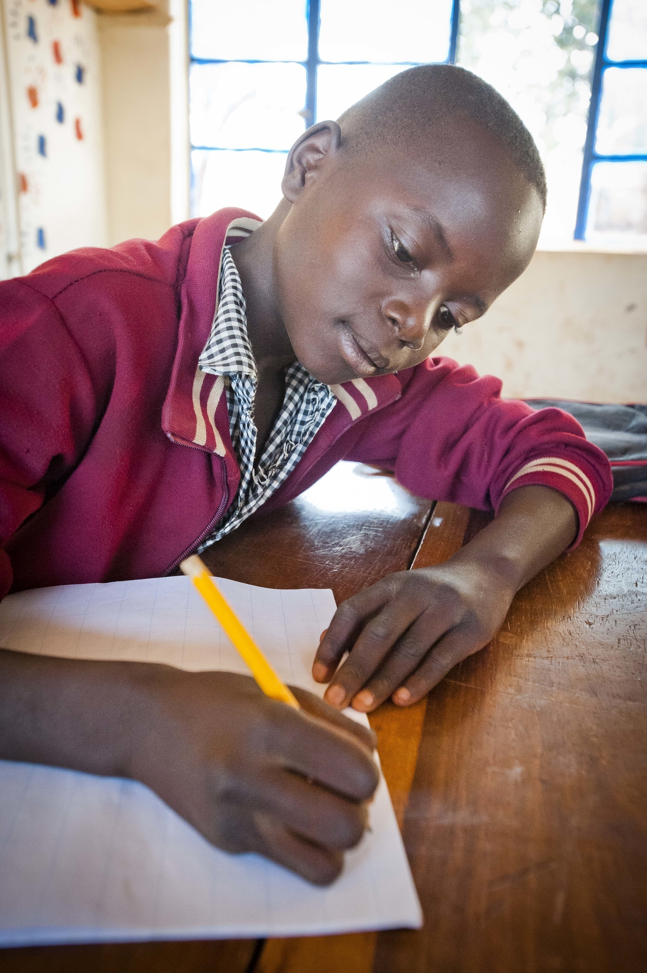
Key resources
Our History:
Our story | Mary's Meals
Our Books:
The Shed That Fed 2 Million Children
Give
Our Films:
Child 31
Love Reaches Everywhere
Generation Hope
Books and Films | Mary's Meals

Slide 16
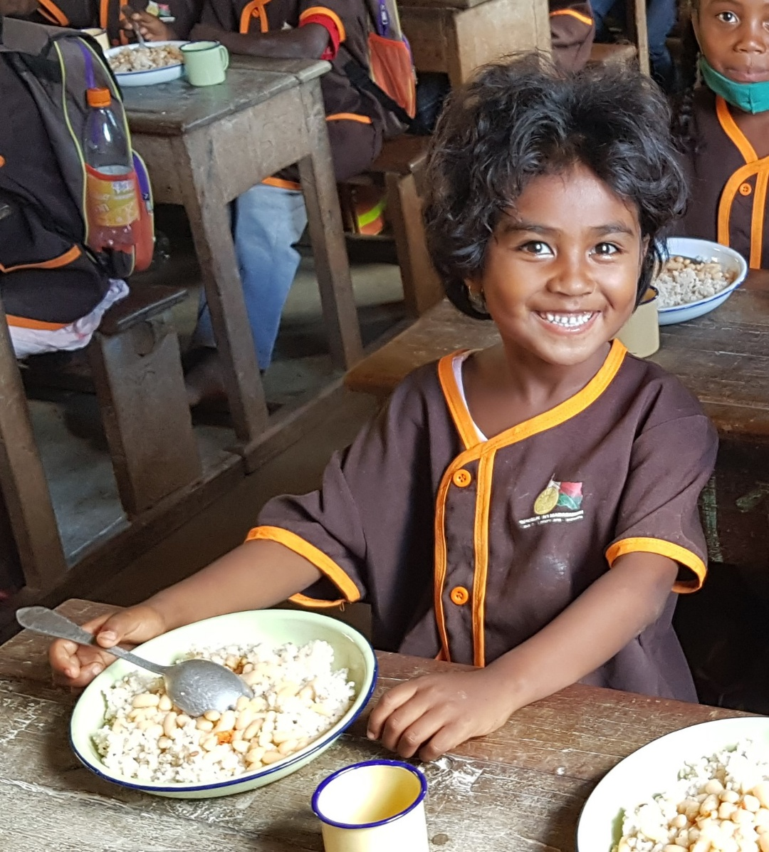
Recruitment process information
How to apply for this role
To apply for the role of Executive Director based at Mary’s Meals UK, please send a tailored CV and covering letter. Your covering letter should make a compelling case for why you feel motivated to apply for this role within Mary’s Meals UK, as well as giving a concise overview of your most relevant skills and experience. Your letter should fill no more than two pages of A4.
Applicants must reside and hold full right to work in the UK.
We welcome applications from candidates of all different backgrounds and identities to apply. We are committed to building an inclusive and diverse charity providing a supportive place for you to do the best and most rewarding work of your career.
Recruitment timescales and process
Closing date for applications is Sunday 2nd March.
Initial MS Teams calls with a member of the People team
1st stage interview – In person presentation and competency-based interview
Final Interview – In person competency-based interview
We reserve the right to close this vacancy at any point, therefore, if you are interested, please submit your application as early as possible.
Please note: If you have any special requirements or adjustments before an interview, please let us know.

Slide 17
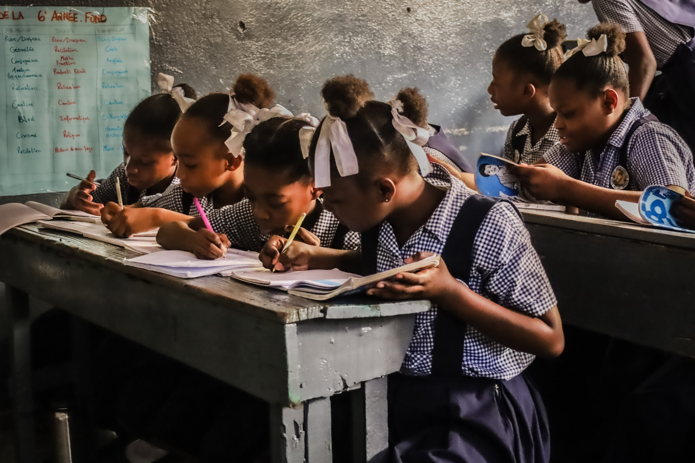
Mary’s Meals UK
Charity No. SC022140
Company No. SC265941
Tel: 0141 336 7094
Dalmally office
Craig Lodge
Dalmally, Argyll
PA33 1AR
Glasgow office
Unit 10-13 Claremont Centre
39 Durham Street, Glasgow
G41 1BS
London office
13 Hippodrome Place
Notting Hill, London
W11 4SF
“Together, let’s set out on this journey; one step at a time, one meal at a time, one child at a time.”
– Magnus MacFarlane-Barrow, Mary’s Meals Founder
“Together, let’s set out on this journey; one step at
a time, one mea at a time, one child at a time.”
– Magnus MacFarlane-Barrow, Mary’s Meals Founder

